Slide 1
Team Aesthetics
Client – The Book Curator
Project – Book data EXTRACTING application to fill CLIENT’S database
Team Members:
David Hayes
Joe Getaruelas
Paul Min Tsu
Derrick Song

Slide 2
The Domain
Client – The Book Curator
Sector – Education
A small team providing intensive support to school librarians
goals
Speed up efficiency
Easier method of data extraction

Slide 3
The Plan
Current semester:
RESEARCH API’s
TEST API’s
Refine data extraction FROM API’s
Still to do this semester:
Design ui
Integrate extracted data into client’s database
Next semester:
Explore barcode technologies for the ability to scan books
Explore extracting book covers to add to the client’s database

Slide 4
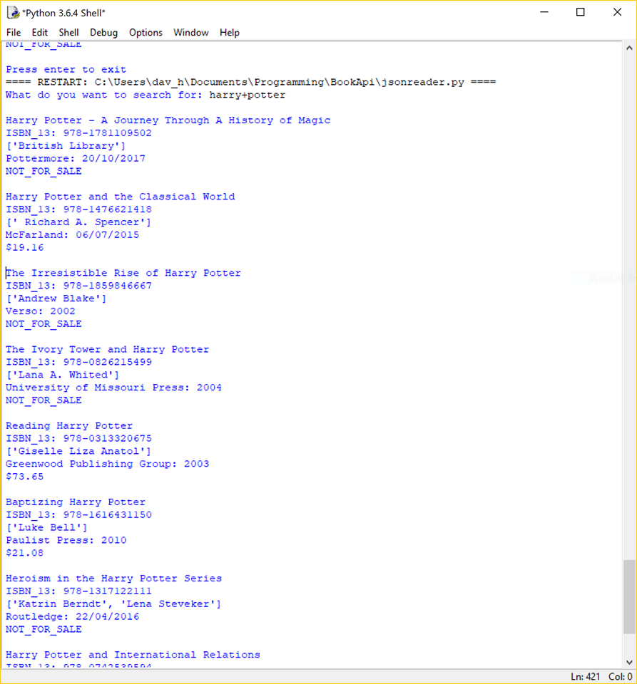
ARTEFACT
Book title
Isbn number
Authors
Publisher
Published date
price

Slide 5
CREDITS
Client – The Book Curator
Team Members:
David Hayes - developer
Joe Getaruelas – business analyst
Paul Min Tsu - developer
Derrick Song - developer

